Slide 1
DataBase Management System Lab (4CS4-22) Experiment No. -5 17-5-2021(Tuesday) Topic to be covered : SET Operations Union , Union all, Intersection , Minus

Slide 2

SQL supports few Set operations which can be performed on the table data.
We will cover 4 different types of SET operations:
UNION
UNION ALL
INTERSECT
MINUS
UNION Operation
UNION is used to combine the results of two or more SELECT statements. However it will eliminate duplicate rows from its result set. In case of union:
Every SELECT statement within UNION must have the same number of columns
The columns must also have similar data types
The columns in every SELECT statement must also be in the same order

Slide 3
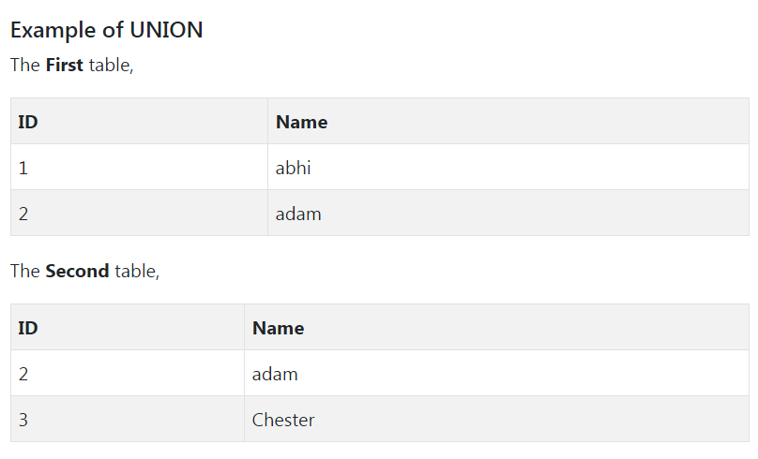
UNION Syntax
SELECT column_name(s) FROM table1 UNION SELECT column_name(s) FROM table2;

Slide 4
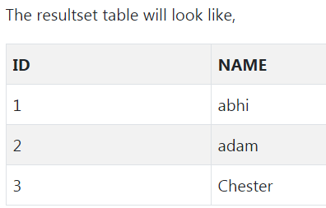
SELECT * FROM First UNION SELECT * FROM Second;
UNION ALL
This operation is similar to Union. But it also shows the duplicate rows.
UNION ALL Syntax
SELECT column_name(s) FROM table1 UNION ALL SELECT column_name(s) FROM table2;

Slide 5
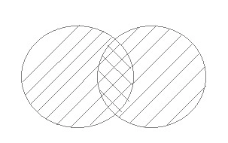
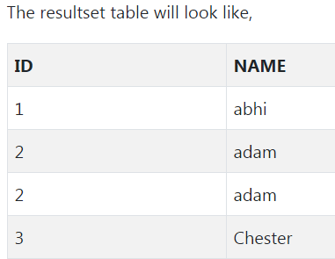
SELECT * FROM First UNION ALL SELECT * FROM Second;
Note: The column names in the result-set are usually equal to the column names in the first SELECT statement.

Slide 6

INTERSECT
Intersect operation is used to combine two SELECT statements, but it only returns the records which are common from both SELECT statements. In case of Intersect the number of columns and datatype must be same.
NOTE: MySQL does not support INTERSECT operator.
SELECT * FROM First INTERSECT SELECT * FROM Second;

Slide 7
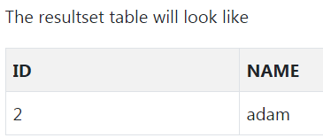

MINUS
The Minus operation combines results of two SELECT statements and return only those in the final result, which belongs to the first set of the result.

Slide 8
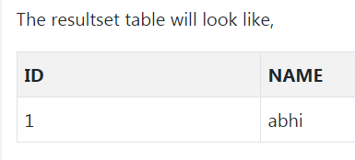
SELECT * FROM First MINUS SELECT * FROM Second;
Note : Minus operation not applicable in MS SQL server

Slide 9
The SQL AND, OR and NOT Operators
The WHERE clause can be combined with AND, OR, and NOT operators.
The AND and OR operators are used to filter records based on more than one condition:
The AND operator displays a record if all the conditions separated by AND are TRUE.
The OR operator displays a record if any of the conditions separated by OR is TRUE.
The NOT operator displays a record if the condition(s) is NOT TRUE.

Slide 10
AND Syntax
SELECT column1, column2, ... FROM table_name WHERE condition1 AND condition2 AND condition3 ...;
OR Syntax
SELECT column1, column2, ... FROM table_name WHERE condition1 OR condition2 OR condition3 ...;
NOT Syntax
SELECT column1, column2, ... FROM table_name WHERE NOT condition;

Slide 11
Example
SELECT * FROM Customers WHERE Country='Germany' AND City='Berlin';
Example
SELECT * FROM Customers WHERE City='Berlin' OR City='München';
Example
SELECT * FROM Customers WHERE NOT Country='Germany';
Example
SELECT * FROM Customers WHERE Country='Germany' AND (City='Berlin' OR City='München');
Example
SELECT * FROM Customers WHERE NOT Country='Germany' AND NOT Country='USA';

